Slide 1
Central Illinois District
Church Extension Fund
Report to the 10th CEF Convention
July 14, 2025

Slide 2
Purpose of the CID-CEF
The Mission of the Central Illinois District Church Extension Fund, Inc. (CID-CEF) is to aid LCMS member congregations and agencies in the Central Illinois District (CID) in building and expanding their facilities and ministries for the growth of God’s Kingdom.

Slide 3
Purpose of the CID-CEF
Investing in the Future of God’s Kingdom!!!

Slide 4
Where Are Funds Currently Invested?
17 Churches
5 School Associations
4 Rostered Church Worker Homes
Current Loan Commitments: $4,110,000

Slide 5
Loans
2024 Loan Balance: $18,617,593

Slide 6
Loan Advances: 2022-2024
Decatur - LSA
Edinburg Trinity
Mattoon St. John’s
Milan St. Matthew
Springfield Concordia
Urbana Trinity
Total New Advances: $4,603,872

Slide 7
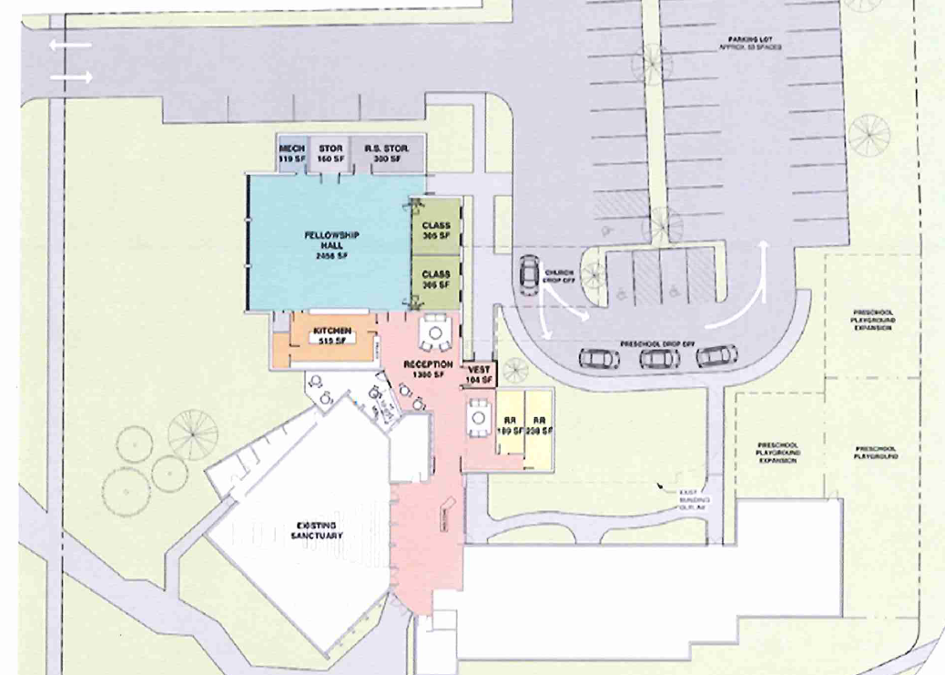
Urbana - Trinity

Slide 8
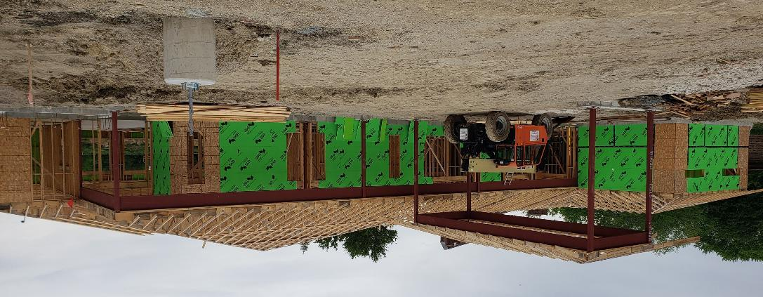
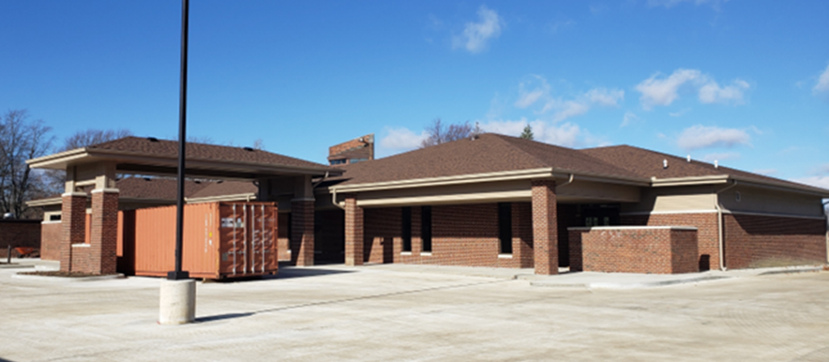
Urbana - Trinity

Slide 9
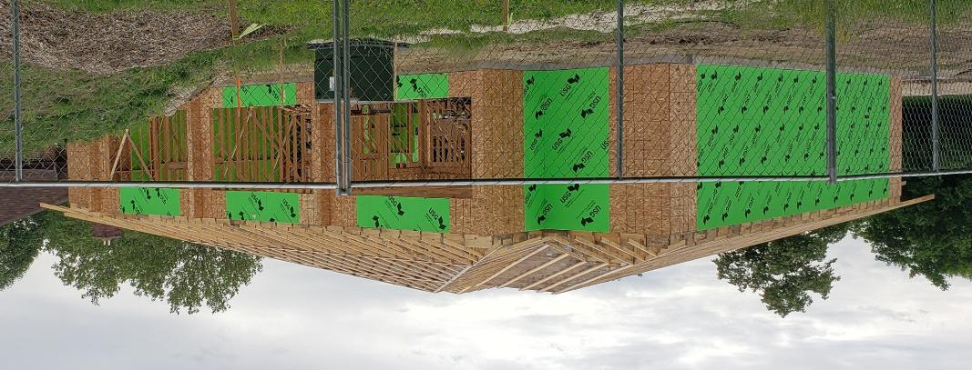
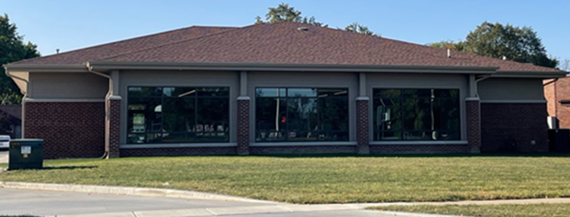
Urbana - Trinity

Slide 10
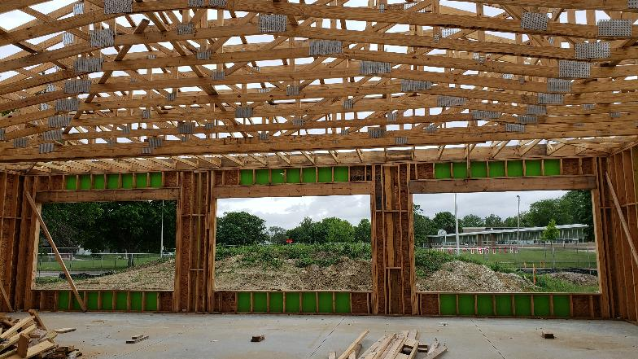
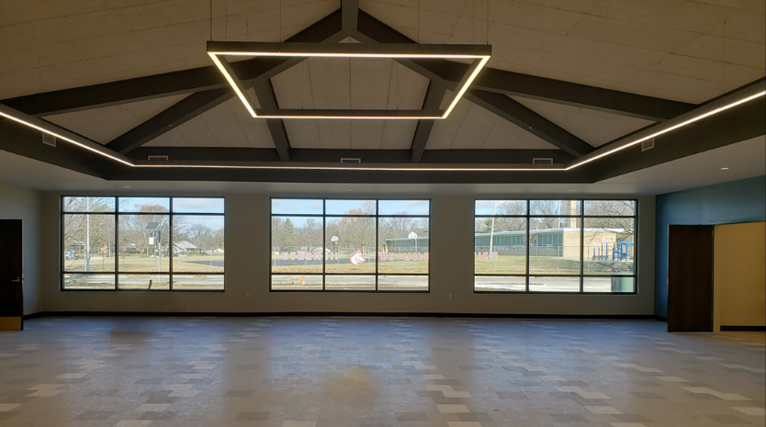
Urbana - Trinity

Slide 11
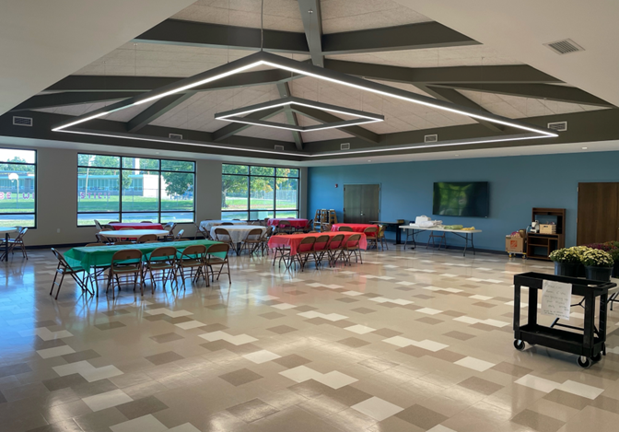
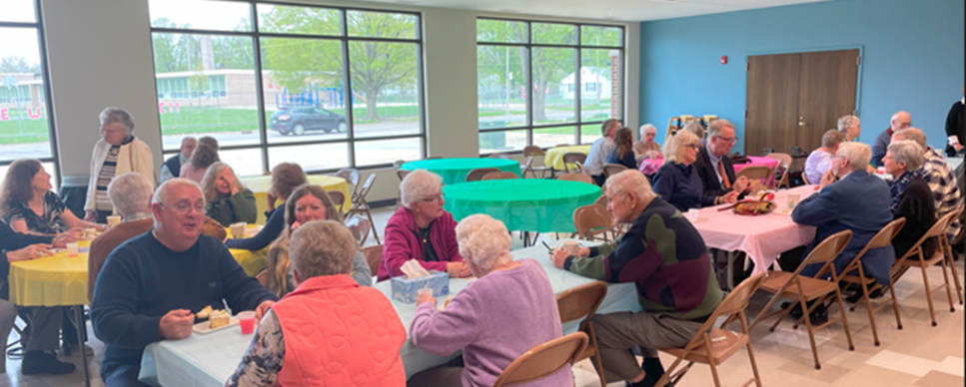
Urbana - Trinity

Slide 12

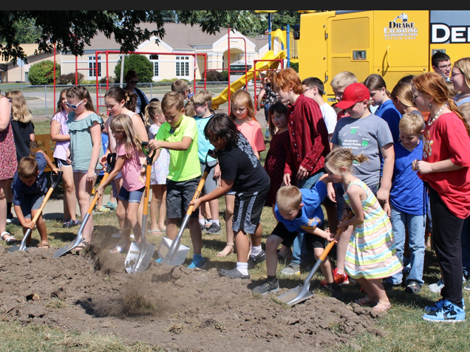
Mattoon
St. John’s High School
Groundbreaking
September 10, 2023

Slide 13
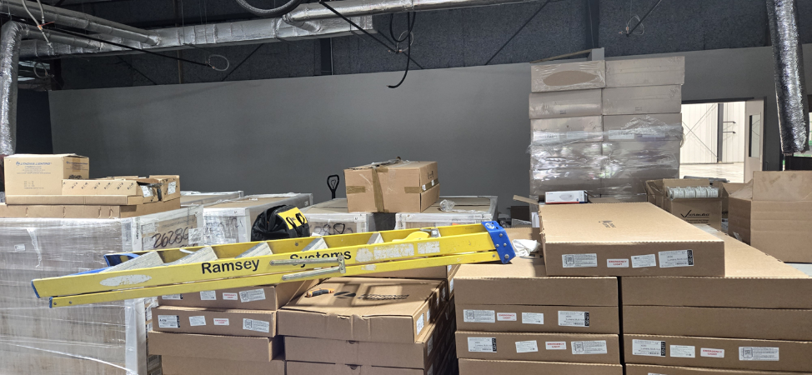
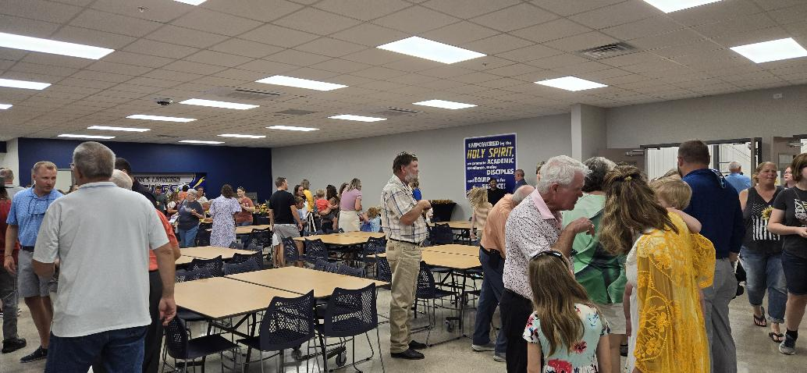
Mattoon St. John’s
High School
Construction
June 2024
Dedication
August 2024

Slide 14
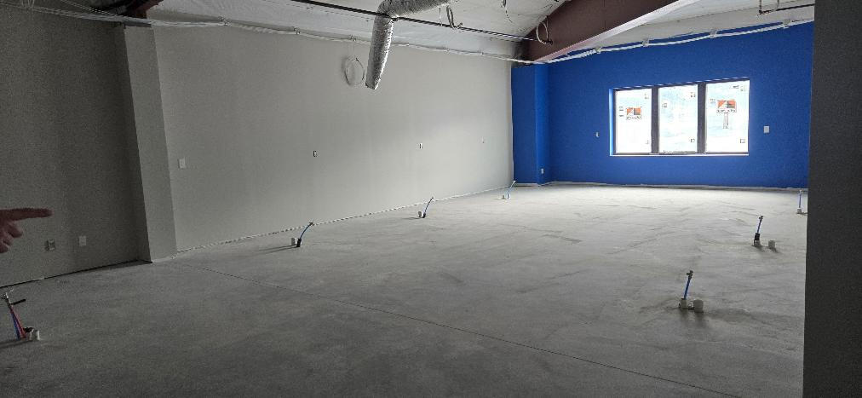
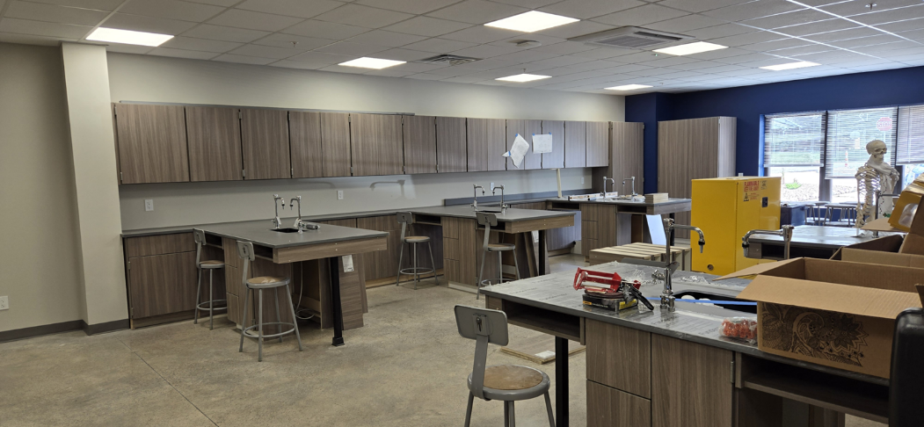
Mattoon St. John’s
High School
Construction June 2024
Dedication
August 2024

Slide 15
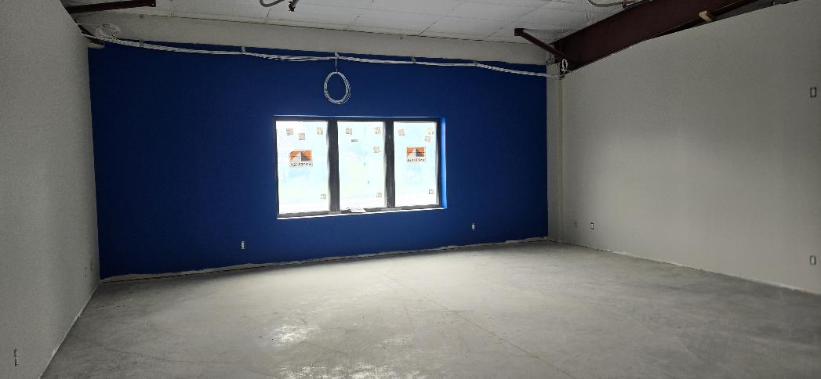
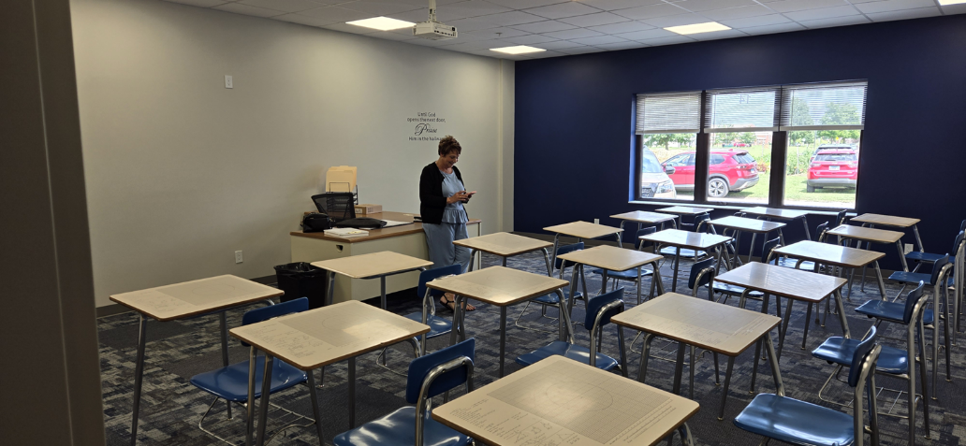
Mattoon St. John’s
High School
Construction
June 2024
Dedication
August 2024

Slide 16
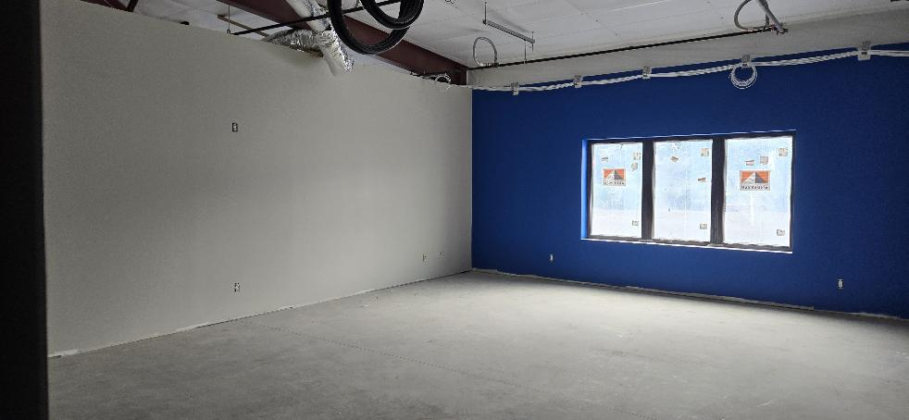
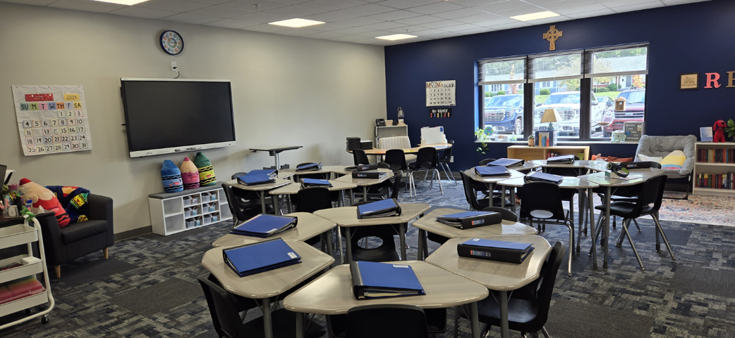
Mattoon St. John’s
High School
Construction
June 2024
Dedication
August 2024

Slide 17
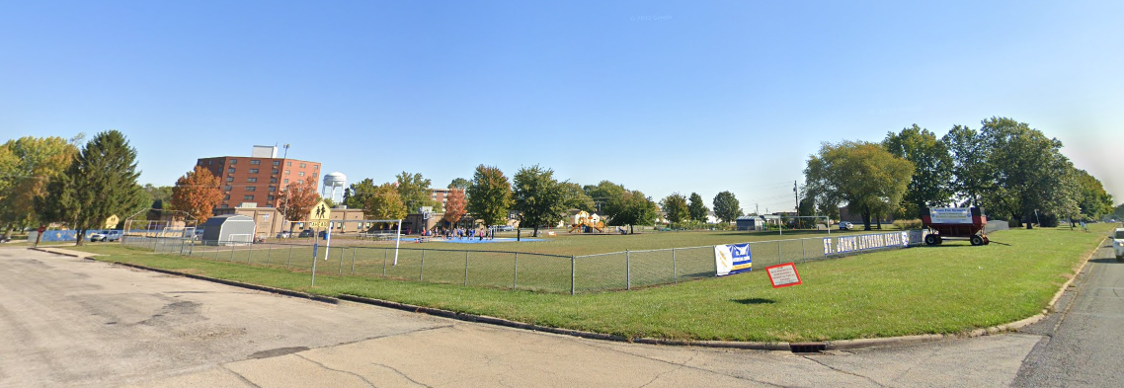
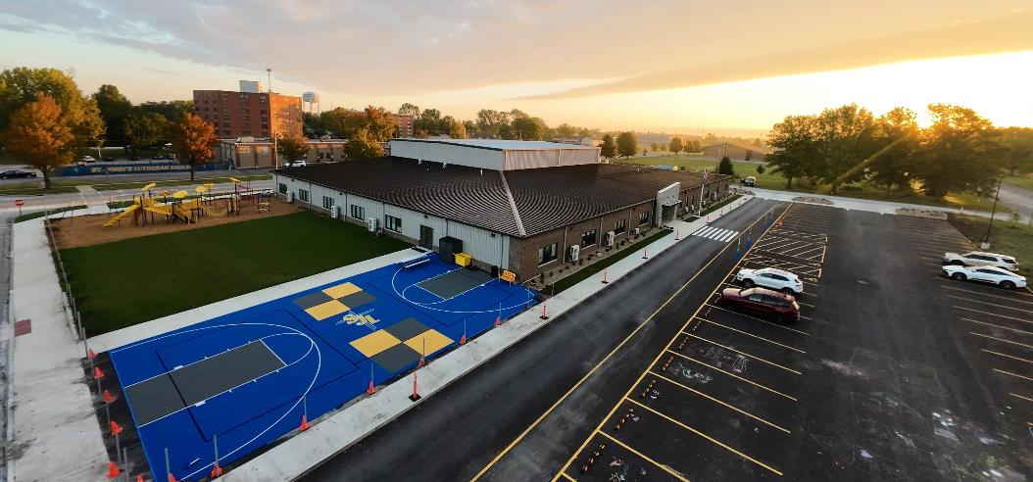
Mattoon St. John’s
High School
Empty lot next to church
High School now occupying empty lot

Slide 18
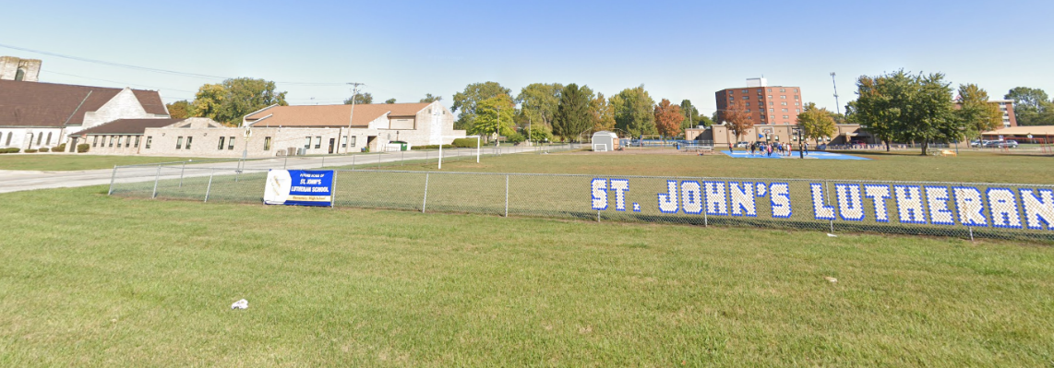
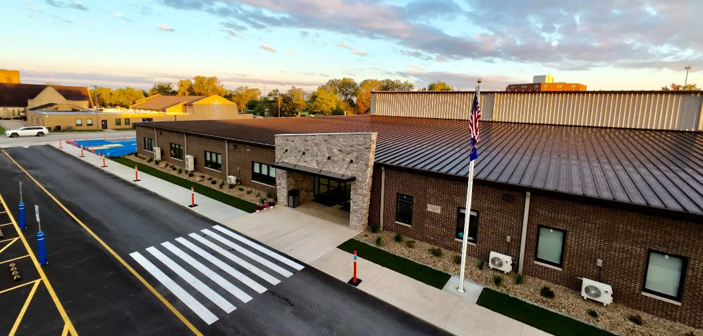
Mattoon St. John’s
High School
Empty lot next to church
High School now occupying empty lot

Slide 19
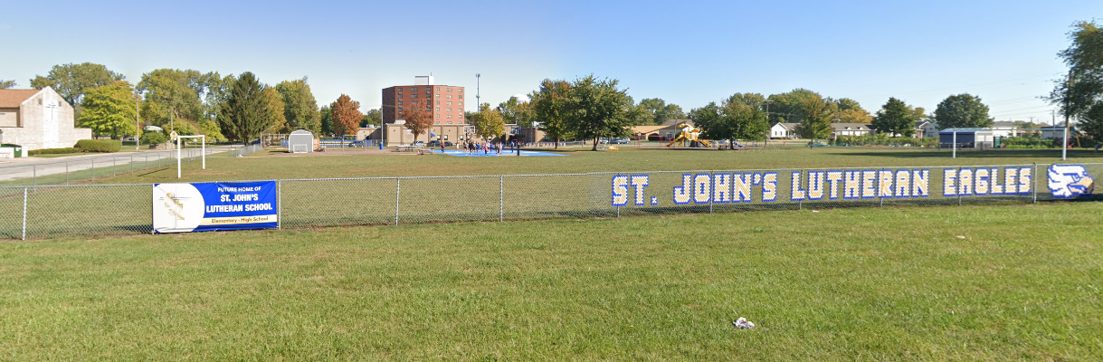
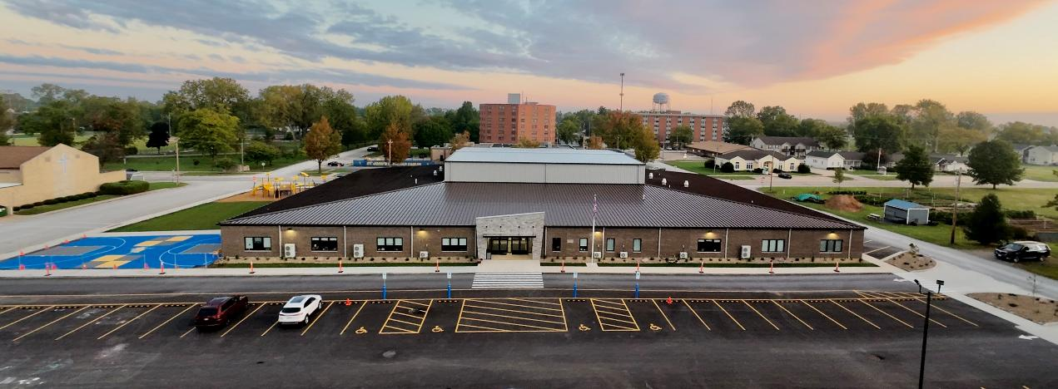
Mattoon St. John’s
High School

Slide 20
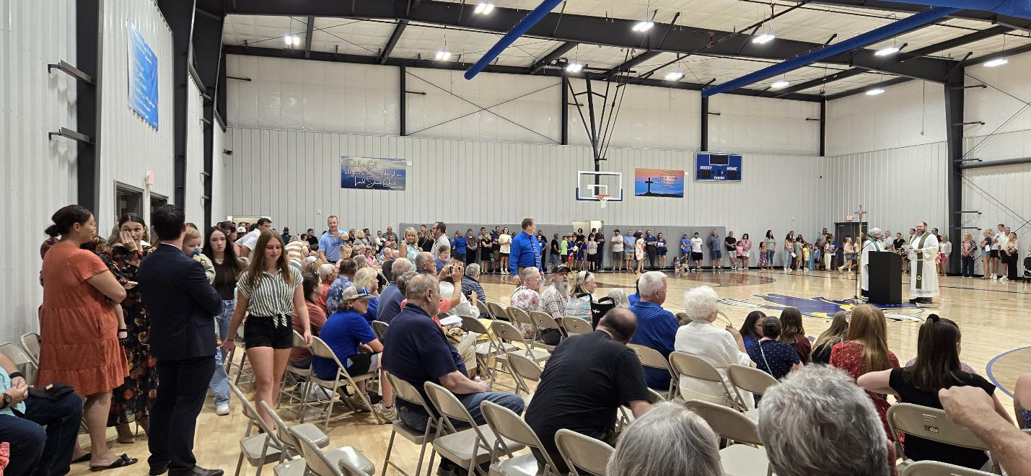
Mattoon St. John’s
High School
Dedication Ceremony – August 11, 2024

Slide 21
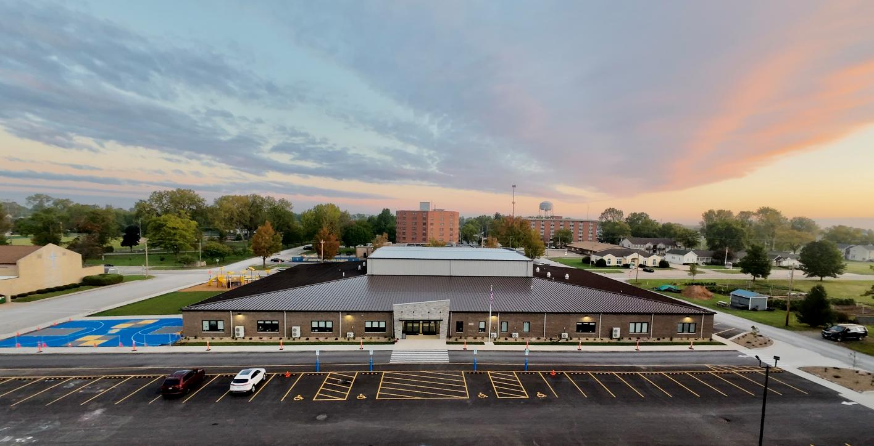
Mattoon St. John’s
High School

Slide 22
Loans: 2025 Approvals
Bloomington Trinity
Danville Trinity
East Moline St. John’s
Total New Loan Approvals: $4,110,000

Slide 23
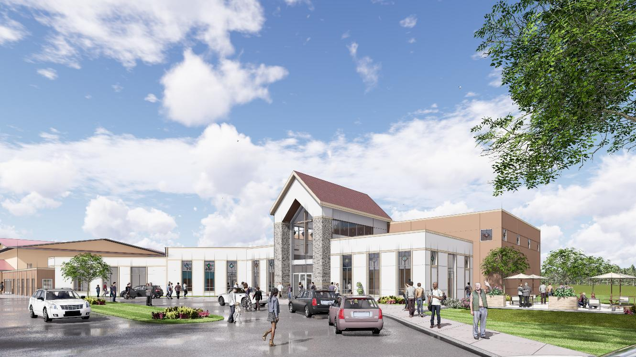
Bloomington Trinity
Proposed Exterior

Slide 24
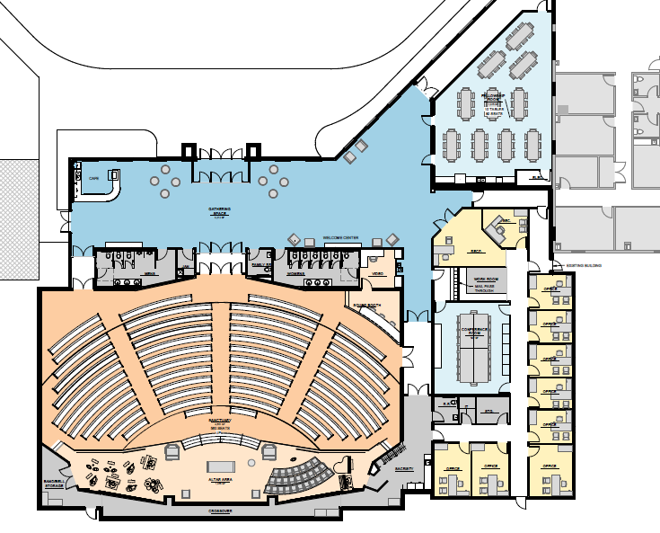
Bloomington Trinity
Proposed Floor Plan

Slide 25
Mortgage Rates
Date CID-CEF Rate Fed Funds Rate
July 2022 5.00% 1.50% - 1.75%
October 2022 5.50% 3.00% - 3.25%
November 2022 6.00% 3.75% - 4.00%
August 2023 6.00% 5.25% - 5.50%
July 2025 6.00% 4.25% - 4.50%
Peak Increase to July 2022 1.00% 3.75%
Current Increase to July 2022 1.00% 2.75%

Slide 26
Mortgage Rates
Current Rate: 6%
Mortgage Interest Rebates in 2024 reduced the interest rate
from 6.00% to 4.55%.

Slide 27
Mortgage Interest Rebates
Total Mortgage Interest Rebates Granted in Past 18 Years:
$3,325,000
Over the past 5 years, an average of 25% of annual interest payments have been returned as rebates.

Slide 28
Investors
2011 Balance: $31,953,106
2025 Balance: $23,980,476

Slide 29
Investors - New vs. Redemptions

Slide 30
Investment Current Rates
Flexible Savings .40%
Capital Campaign Savings 1.00%
Investment Certificates:
6 Month .75%
1 Year 2.00%
3 Year 2.25%
5 Year 2.50%
Special 11-Month Term 3.75%

Slide 31
Our Investments
2024 Balance: $17,695,216

Slide 32
Capital to Asset Ratio
Recommended Minimum:
LCMS BCE: 11% NASAA: 5%
CEF Ratio: 28.01%

Slide 33
Annual Expenses

Slide 34
Grants
Total Grants in Past 18 Years:
$1,716,000
Grant Total 2022 – 2024: $216,412
Main Grant Recipients in Last 3 Years:
  $71,695 CID Programs and Projects
  $51,465 Support of LuHi
  $35,000 Seminarian and Deaconess Grants
  $30,552 District-Wide Initiatives
  $ 9,700 Campus Ministries
  $ 9,000 Specific Church Projects
  $ 5,000 LCMS Disaster Relief – Hurricanes
  $ 4,000 Cristo Rey

Slide 35
Grants
Ministry Outreach Grants
Offered twice a year – deadlines for application receipt:
April 1
October 1
Applications Received from Churches/Ministries:
Year April 1 October 1
2022 0 3
2023 4 0
2024 2 0

Slide 36
Grants
Ministry Outreach Grants
OUTREACH IDEAS:
Reaching the Unchurched
Involving Youth and the Congregation in the Church’s mission and ministry
Confronting the effects of societal change and technological advancements on congregations and schools
Meeting the needs of multi-cultural communities
Addressing the needs of rural congregations and schools
Addressing the growing needs of the elderly within our communities

Slide 37
Grants
Ministry Outreach Grants
CATEGORIES:
Seed Grants – for projects that initiate new models of ministry
Support Grants – assist or augment projects or programs that minister to a wider or diverse group and benefit members and the community
Professional Development Grants – support conferences, seminars, workshops, etc. for the development, training, and encouragement of workers in the Kingdom

Slide 38
Grants
Ministry Outreach Grants
EXCLUDES:
Capital expenses – building, equipment, maintenance or improvements
Items already budgeted
Projects requiring continued CID-CEF funding
Expenses for salaries, benefits or expenses normally budgeted
Fund-raising campaigns or contributions to endowments

Slide 39


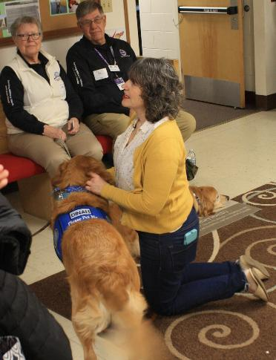



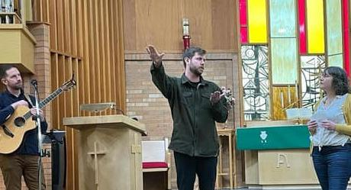
Grants
Ministry Outreach Grants

Slide 40

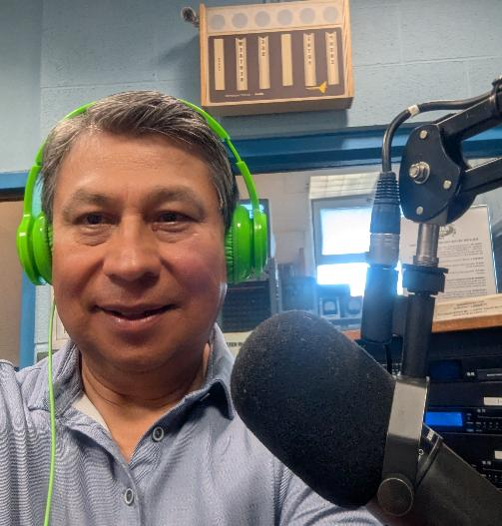

Grants
Ministry Outreach Grants
Spanish Radio Broadcast

Slide 41
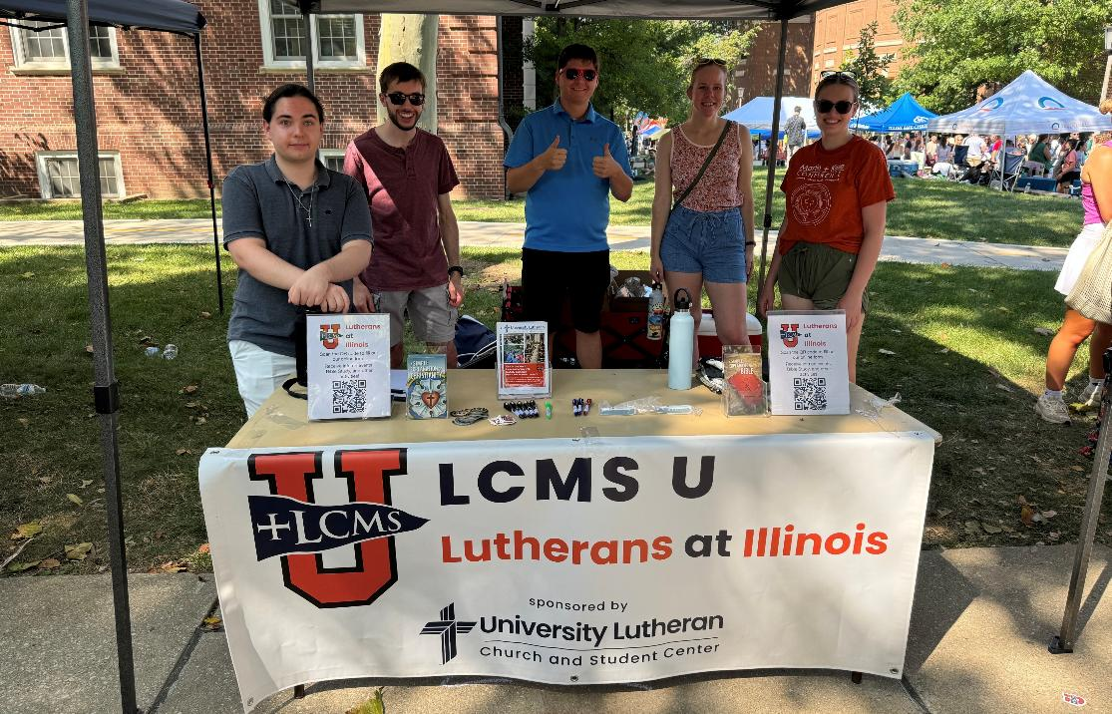
Grants
Ministry Outreach Grants
University Lutheran Quad Day Outreach

Slide 42

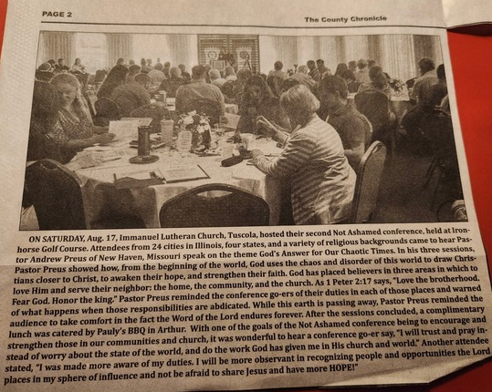

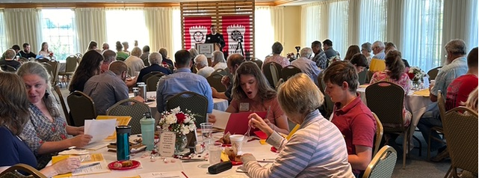
Grants
Ministry Outreach Grants

Slide 43
What Else Has Been
Going On?
Revision and legal review of internal policies and documents
Implementation of new Accounting Standards
Finding new insurance carriers
Resumed summits with CEF’s and LCEF
Board of Trustees Retreat
Implementation of new software

Slide 44
What’s Next
Stay Tuned!
Online Access to Account Information

